Slide 1

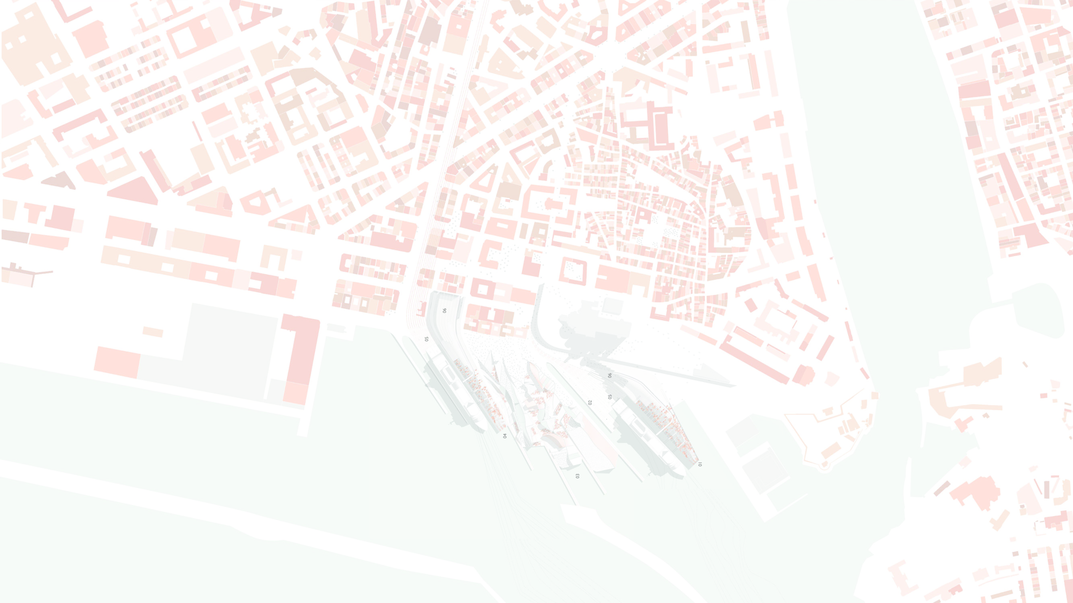









MOBILITY ISLANDS
A New Typology for Urban Connectivity in Burgas

Slide 2







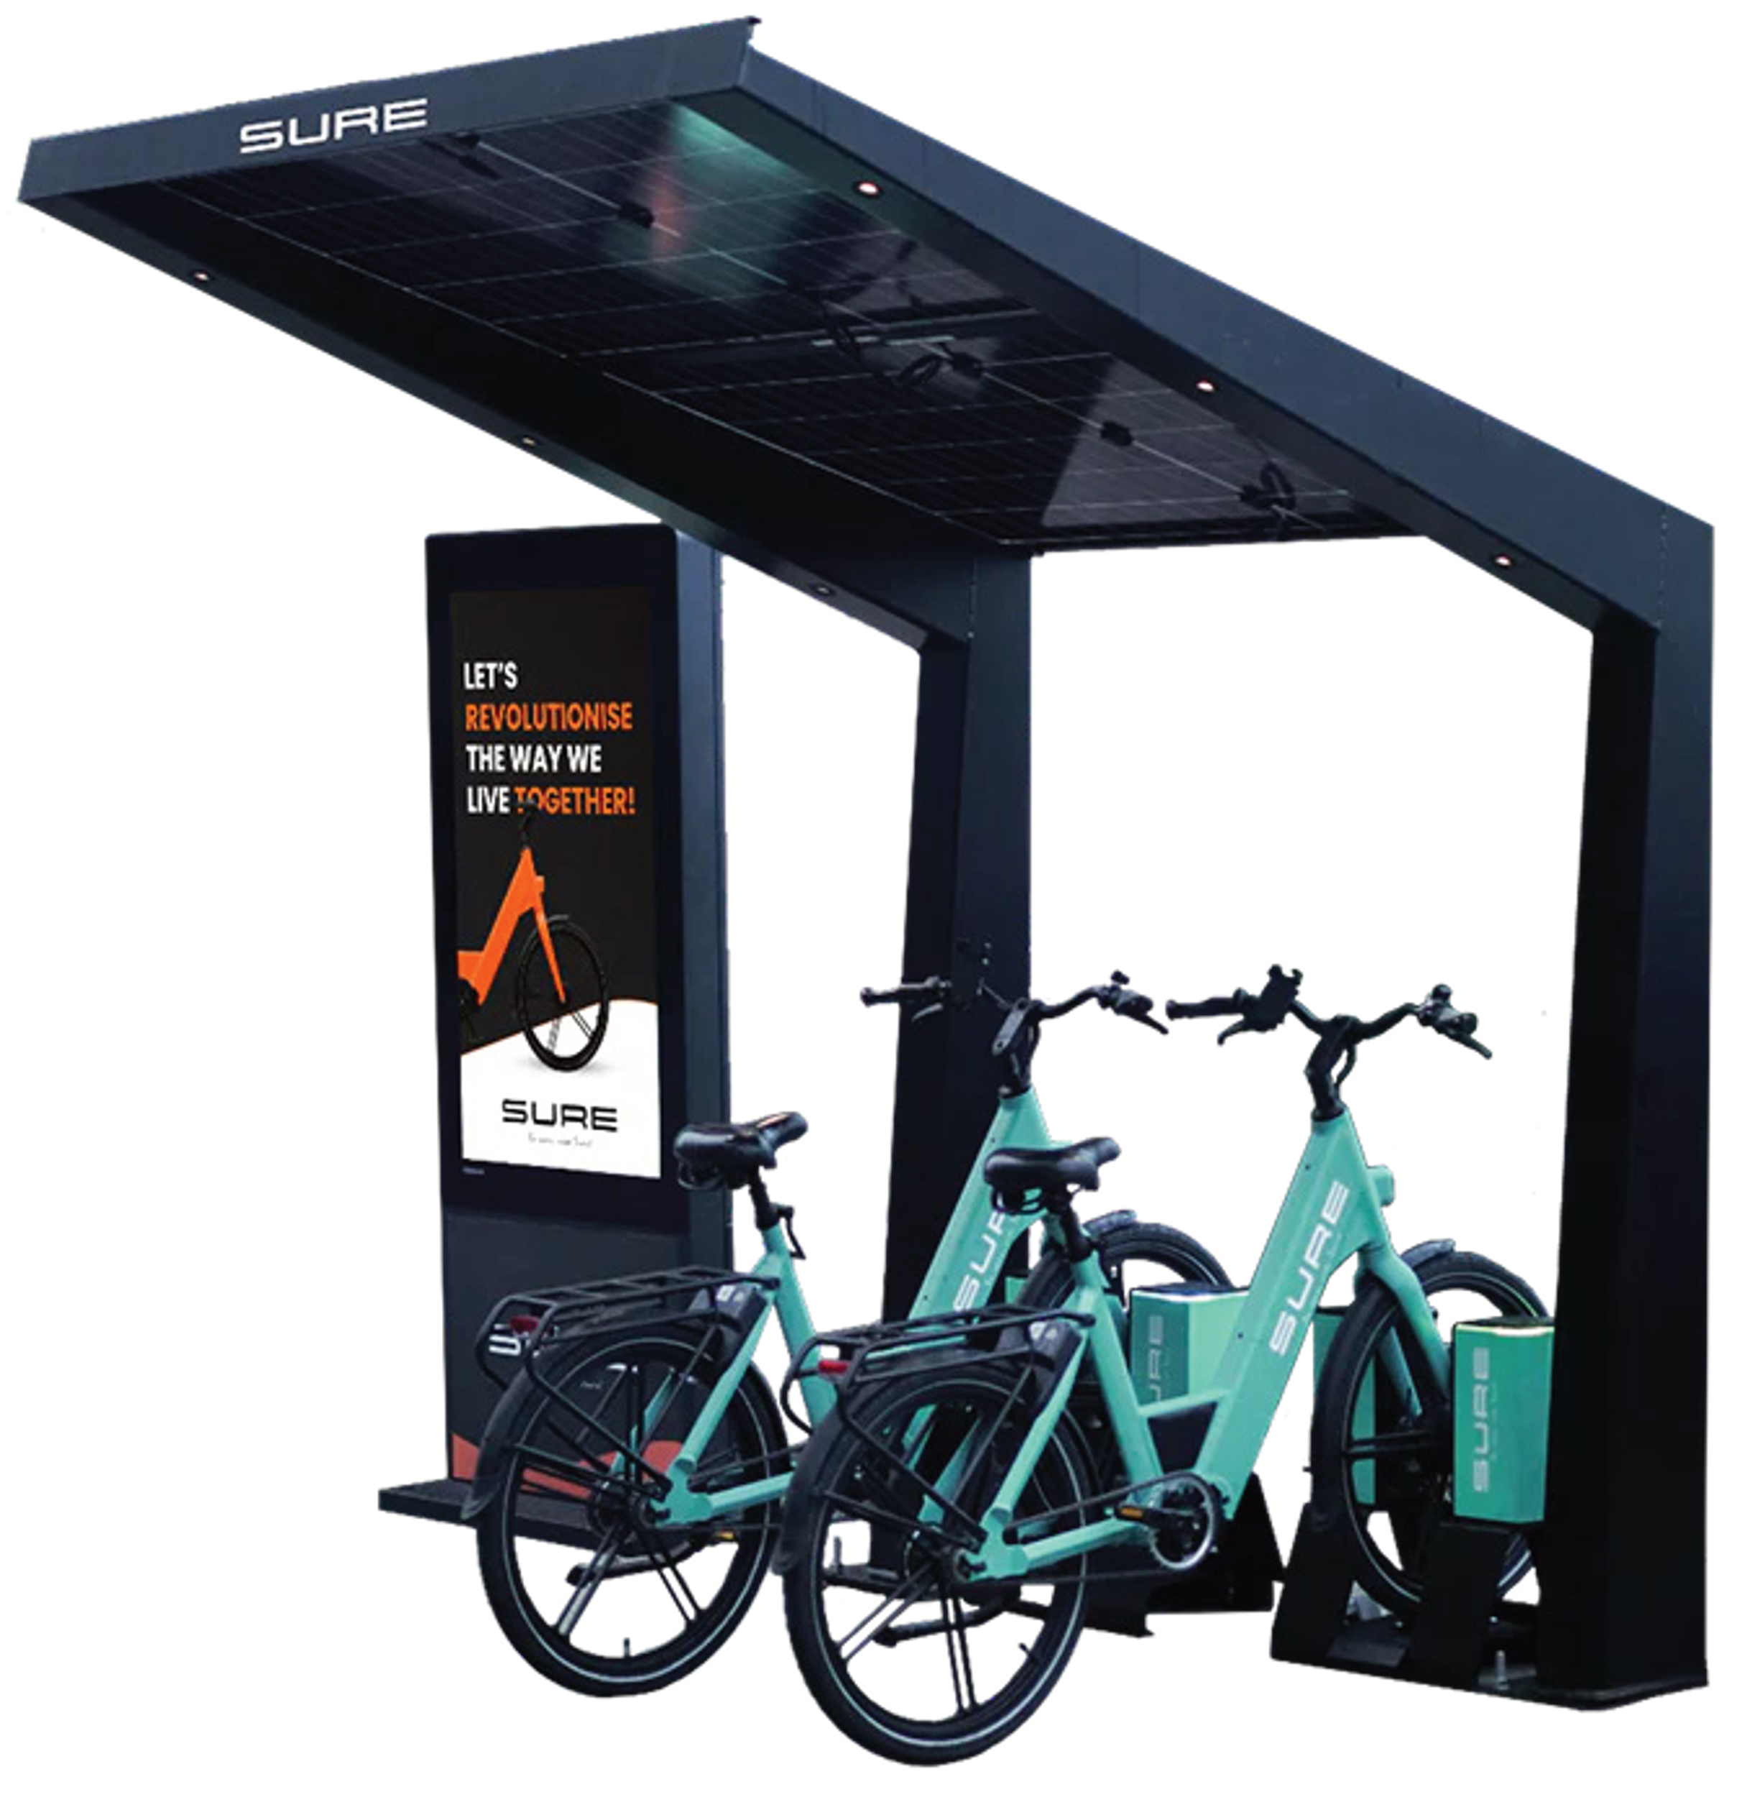
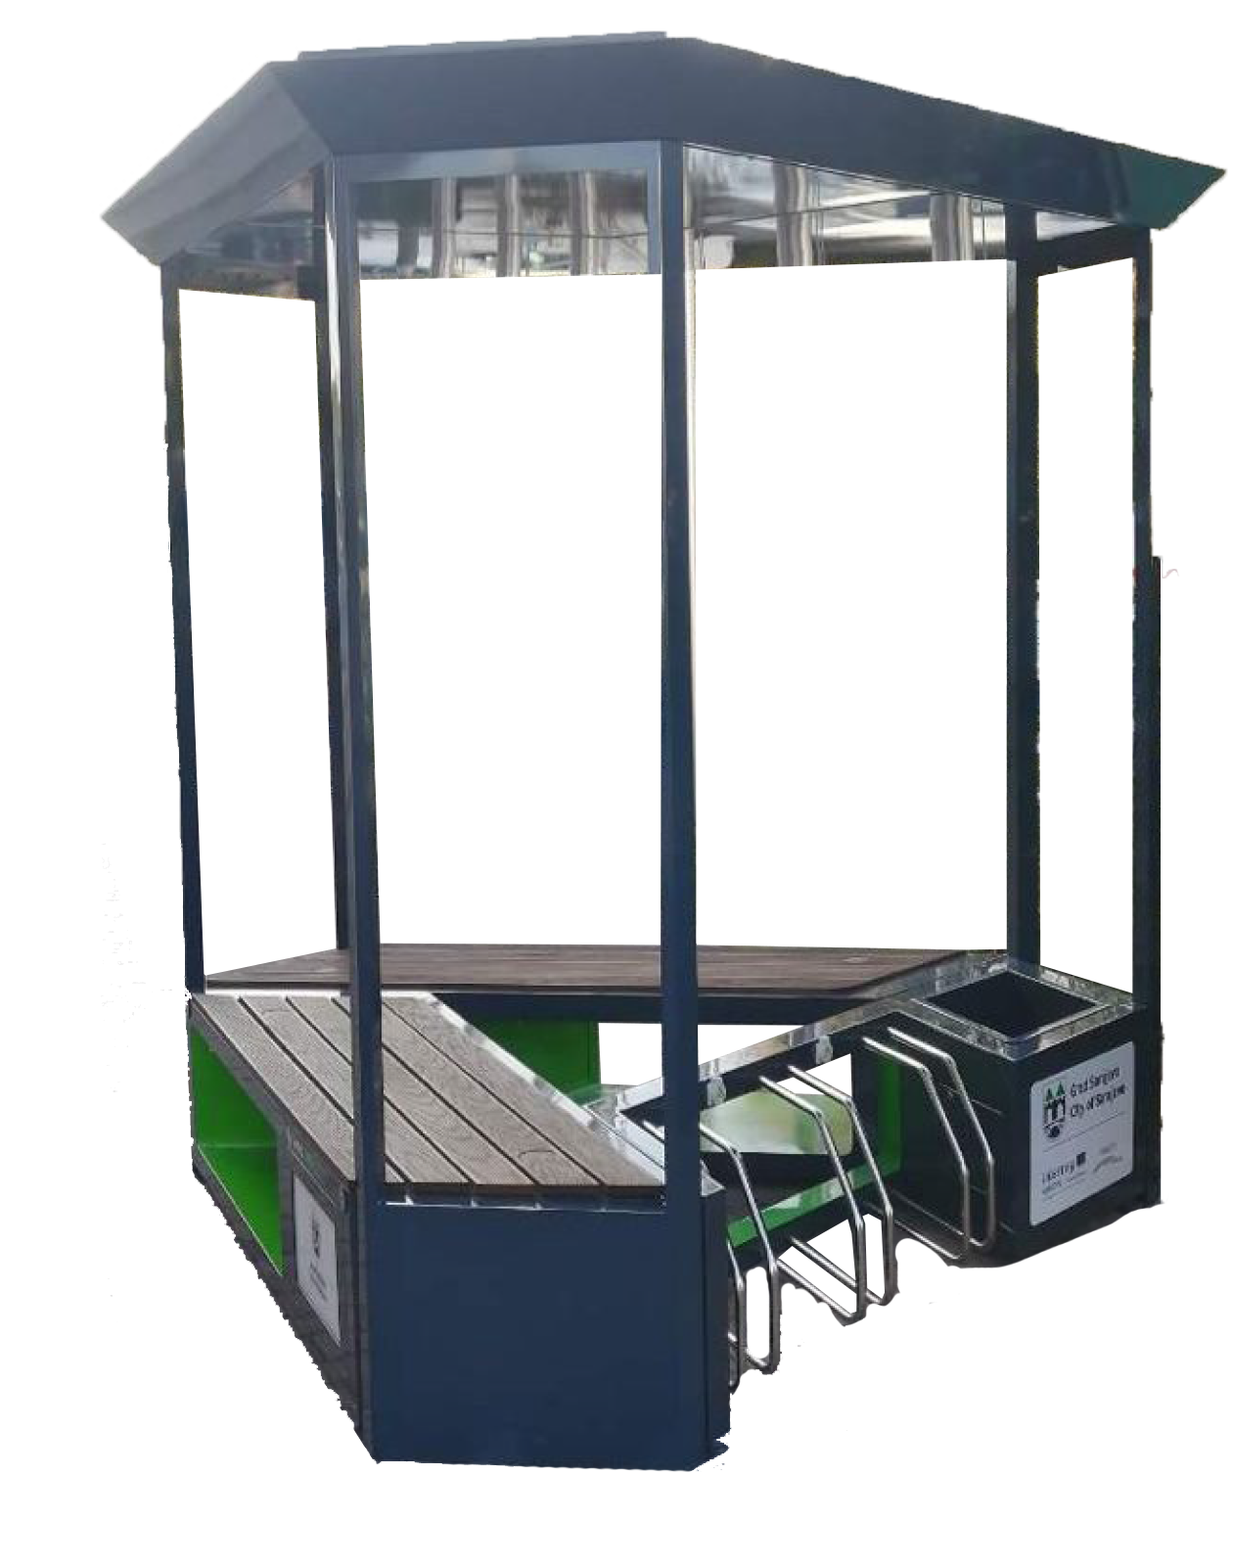
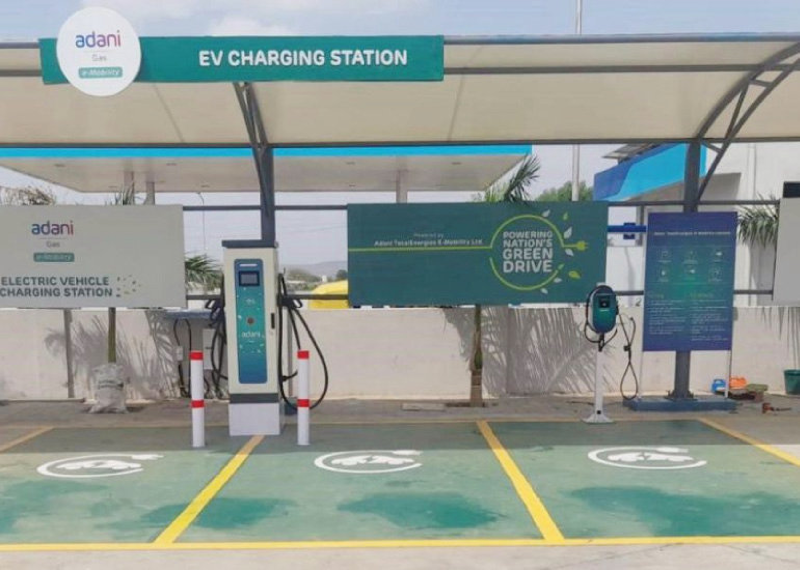
What is a Mobility Island?
A Mobility Island is a multifunctional, visible physical facility designed to serve as a central hub for various green transport modes and pedestrians, supporting sustainable urban mobility.
Supports Multiple Transport Modes
Bridges Transport Modes
Bicycles, e-scooters, e-cars, and pedestrians
Encourages seamless transitions between different mobility options
Essential Services
Charging points, secure storage, and rest facilities
Strategic Location
Within a 5-minute walk of any point in the city

Slide 3
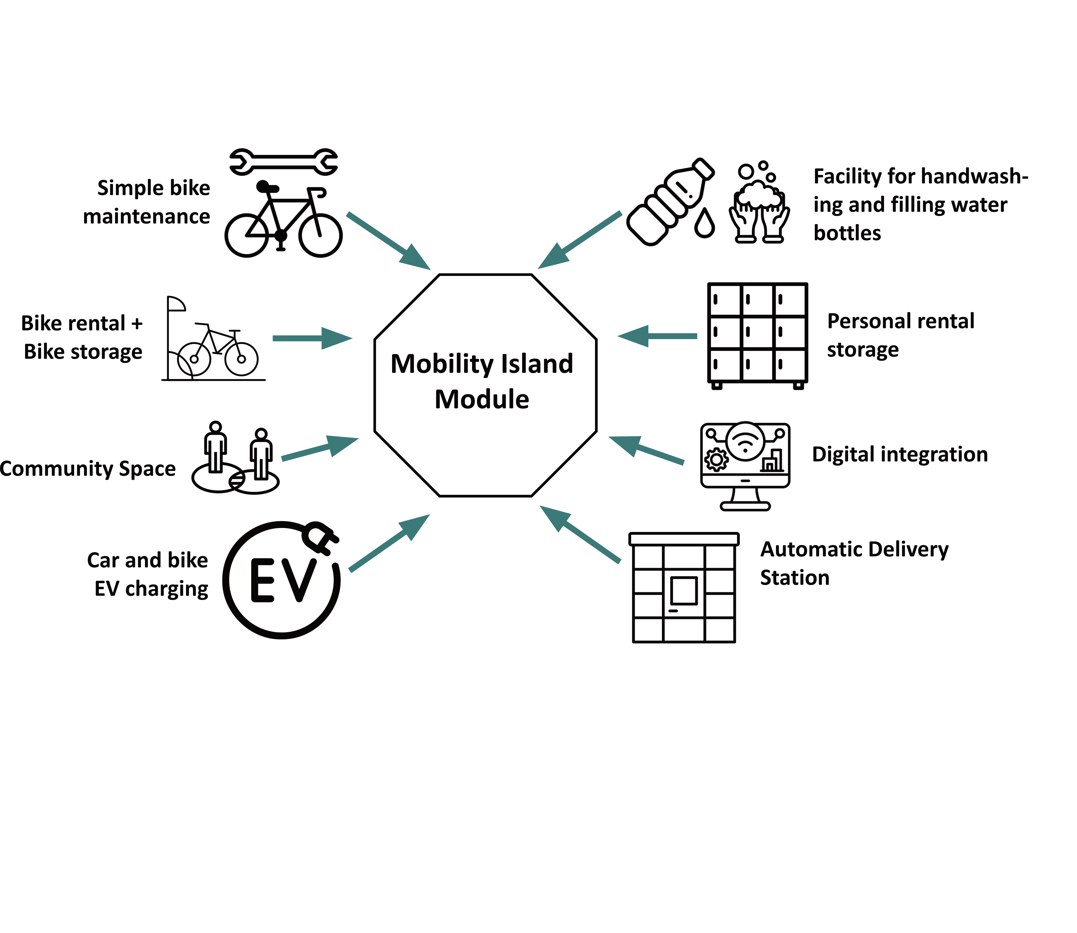
Core Features of Mobility Islands
Based on the Sharing Cities model

Slide 4

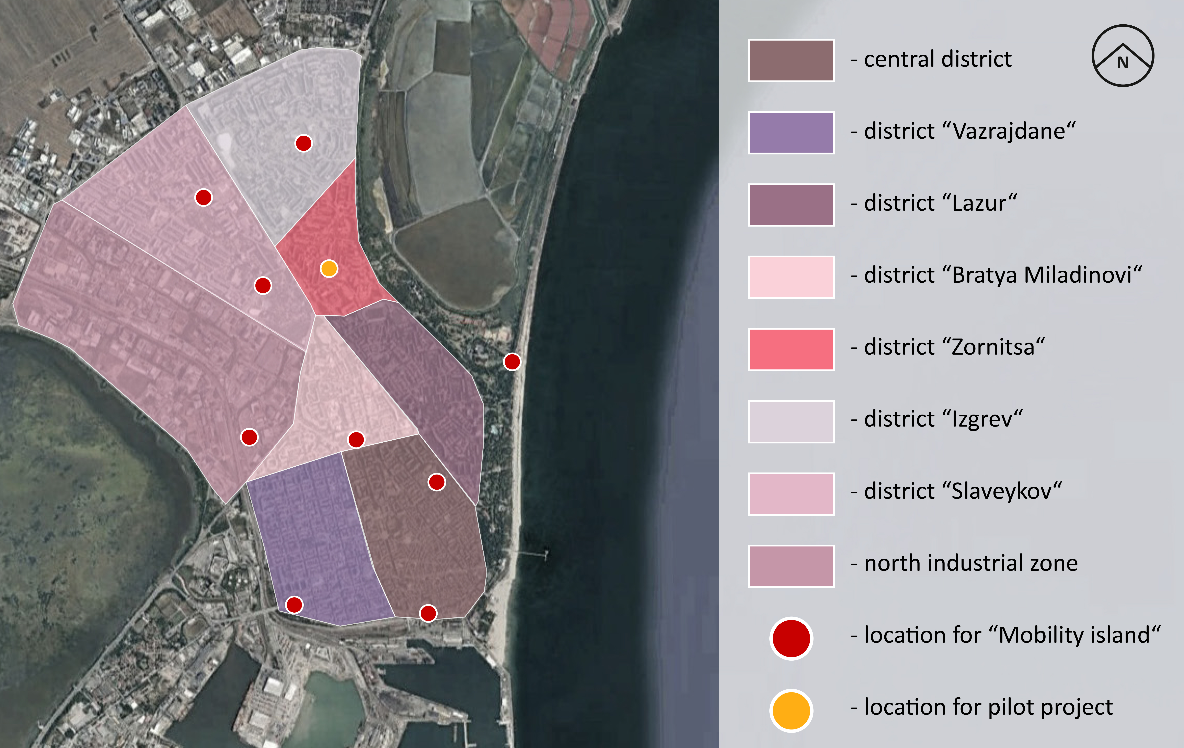






Vision: A Citywide Network
Moving beyond isolated hubs, Burgas envisions a comprehensive citywide network of Mobility Islands, creating an integrated infrastructure that transforms urban mobility, energy management, and leisure activities across the city.
Strategic Locations
Chosen possible locations for Mobility islands in Burgas
Sports Arenas & Cultural Hubs
Facilitating sustainable transport for events, reducing traffic congestion
Residential Neighborhoods
Providing convenient access to shared mobility options for daily travel
Coastal Areas
Supporting sustainable tourism and leisure with marine infrastructure

Slide 5










Benefits for the City
Mobility Islands will transform Burgas through these key benefits:
Reduced Traffic & Emissions
Enhanced Accessibility
Decreased private vehicle use
Inclusive design for all citizens
Lower traffic congestion
Access for disabled, families, and elderly
fewer CO₂ emissions
Equitable mobility options
Vibrant Urban Spaces
Innovation Leadership
Green areas and public seating
First of its kind in Bulgaria
Art installations and cultural elements
Enhanced reputation as a smart city
Integration of transport, leisure, and culture
Attracts investment and partnerships

Slide 6
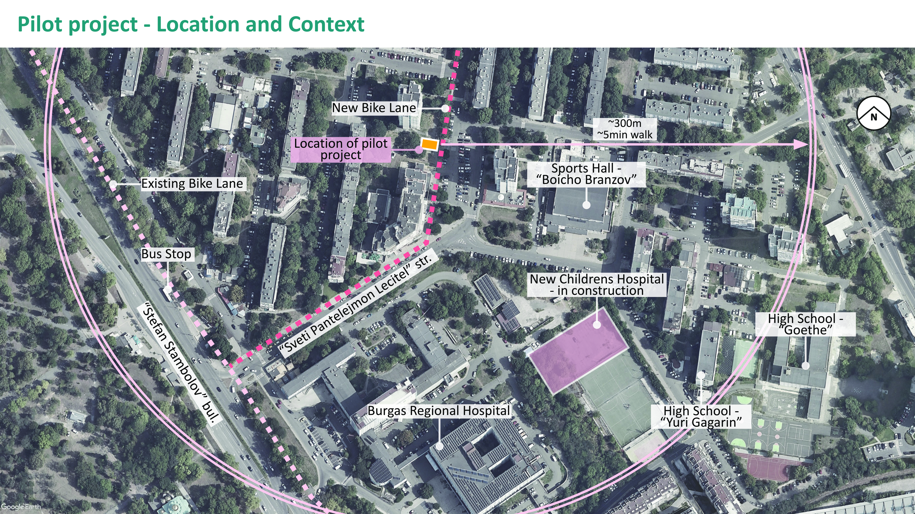
Pilot project - Location and Context

Slide 7
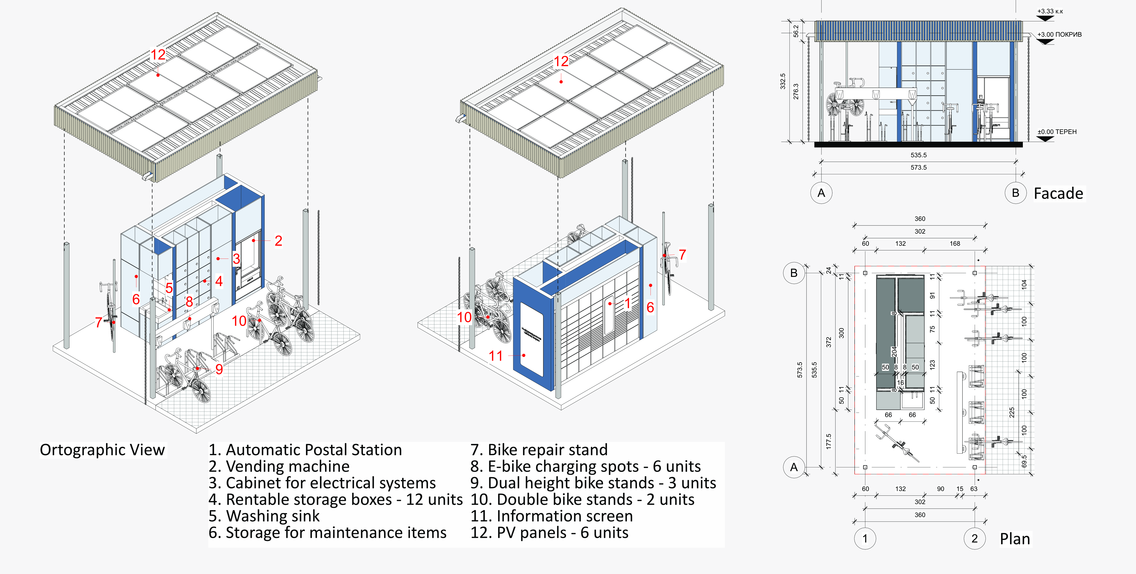
Pilot project - The Module

Slide 8
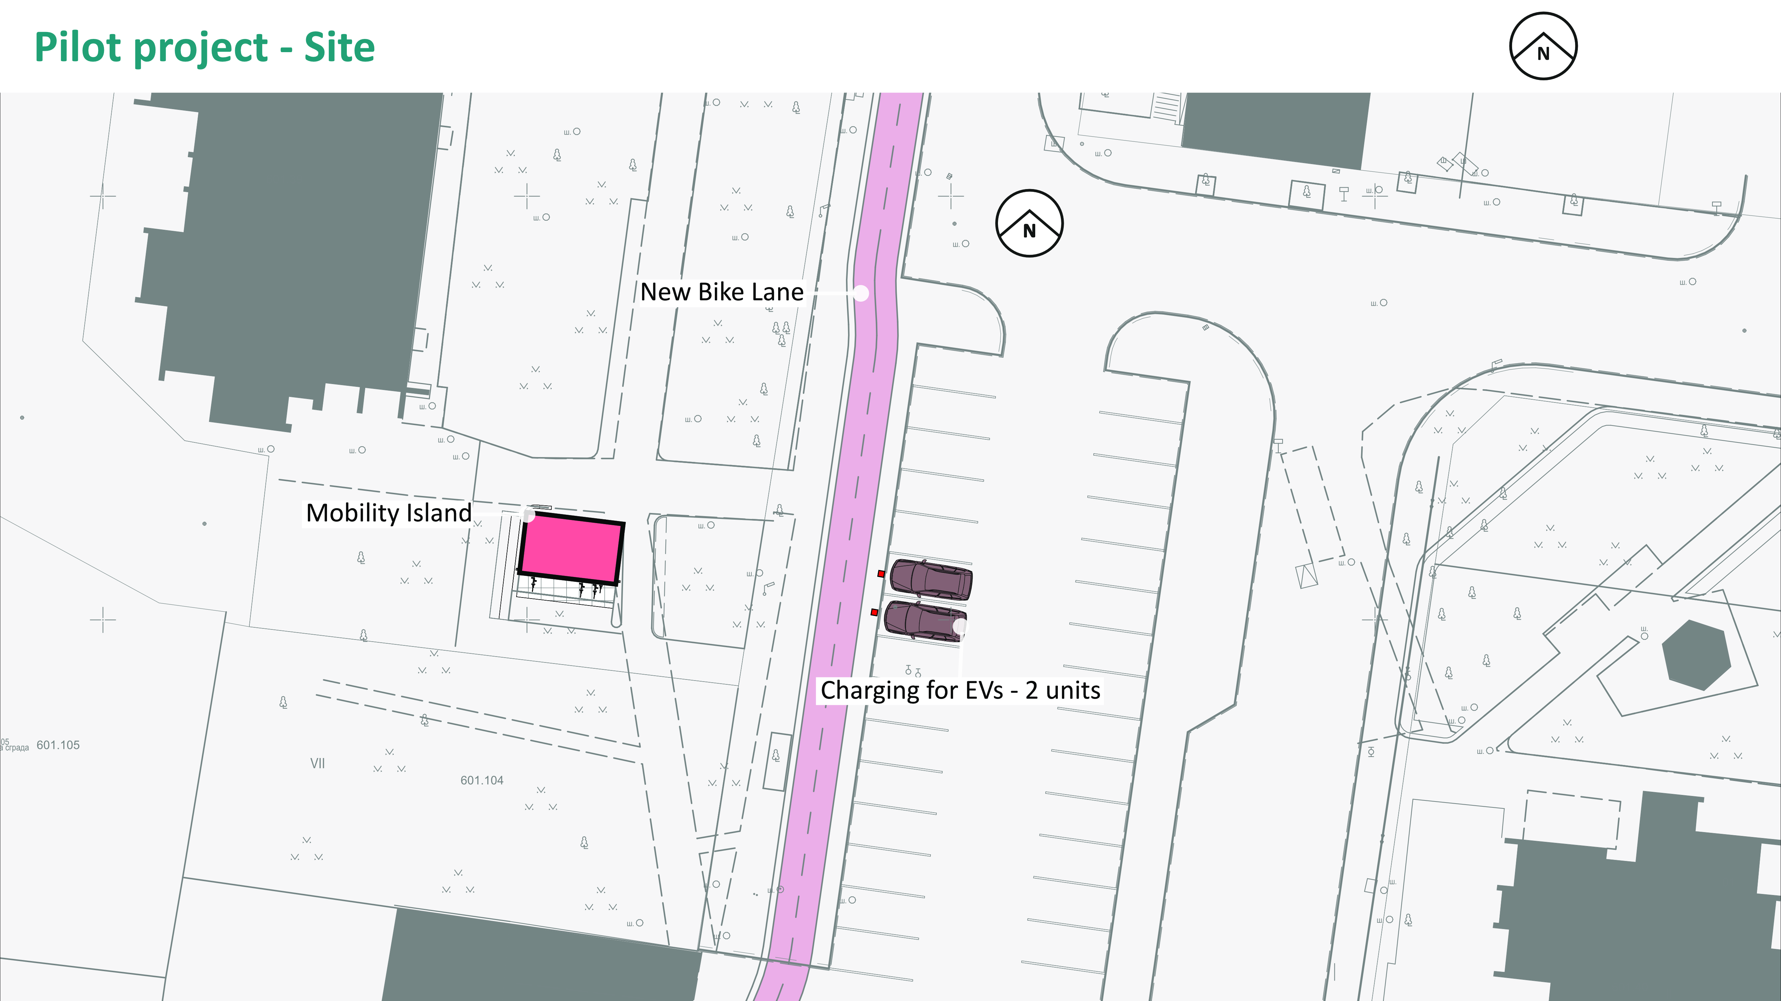
Pilot project - Site

Slide 9
Thank you for your attention!

